Slide 1


Slide 3
Welcome to our Zomato Data Analytics Project presentation, where we'll delve into the world of online food delivery and uncover key insights into Zomato's performance. As one of the global leaders in the food delivery market, Zomato's data offers a fascinating case study. Join us as we explore the metrics that matter most and reveal trends, patterns, and opportunities for growth.
This research leverages the comprehensive Zomato Restaurants Data, sourced from a leading online platform that enables users to discover top-rated restaurants in their vicinity. The platform facilitates searches based on diverse criteria, including cuisine, estimated cost for two people, reviews, ratings, and user votes, providing a rich dataset for analysis.
The Zomato Restaurants dataset offers a comprehensive overview of restaurants worldwide, featuring essential attributes that cater to the needs of frequent diners. Key metrics include user votes, aggregate ratings, and average cost for two, providing valuable insights for users to make informed decisions about their dining experiences. Furthermore, this data can facilitate the identification of top-rated restaurants and inform constructive reviews, ultimately driving improvements in the culinary industry."

Slide 4
Capturing essential details that enable insights into restaurant popularity, customer preferences, and overall business performance.
Key Features of the Dataset:
Restaurant Name: The designated title of the restaurant.
City/Location: The geographical area or address of the restaurant.
Cuisine: The specific categories of food served at the restaurant, like Italian, Chinese, or Indian.
Average Cost for Two: Zomato Restaurants Dataset provides an extensive collection of data on restaurants from cities worldwide typical cost for a meal for two, which provides the overview of the restaurant's pricing approach.
Aggregate Rating: A weighted average score calculated from customer reviews, offering a comprehensive measure of overall satisfaction and restaurant quality.
Votes: The total count of customer votes, serving as an indicator of the restaurant's popularity and the extent of customer interaction.
Reviews: Detailed customer feedback and ratings based on their dining experience, offering insights into the restaurant's quality and service.
Online Order Availability: Specifies whether the restaurant offers the convenience of placing orders online for delivery or takeout.
Table Booking Availability: Specifies whether the restaurant offers the option for customers to make online reservations for a table in advance.
Restaurant Type: Classifications like casual dining, fast food, cafes, fine dining, and more.
Country: Country where the restaurant is located.

Slide 5
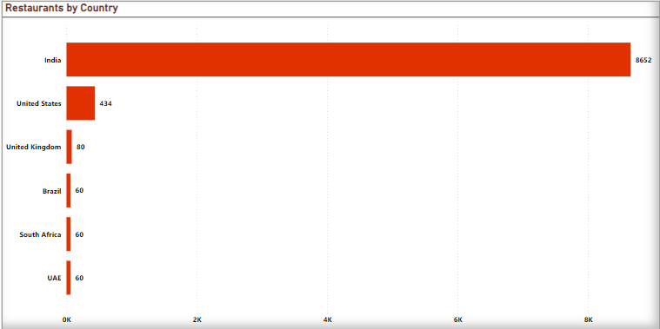
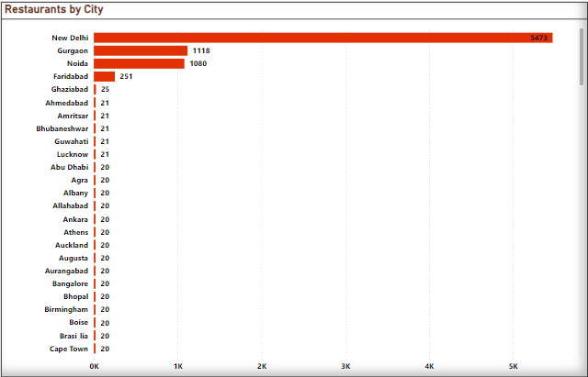
Number of Restaurants based on Country and City
Zomato's largest presence is in India, where it dominates the restaurant market. Following this, it has a strong foothold in the United States and the United Kingdom, where it is recognized as a reliable platform for discovering restaurants and enhancing dining experiences.
Emerging markets such as the UAE and Australia demonstrate significant growth potential, with the number of listings steadily increasing, highlighting expanding opportunities in these regions.
Key Insights:
India: India holds the largest market share for Zomato, featuring a substantial number of restaurants across key cities such as New Delhi, Gurgaon, and Noida. Total Restaurants: 8,652 United States: The U.S. is another key market for Zomato, boasting a wide range of high-end and diverse restaurants, especially in cities like New York, Los Angeles, and Chicago. Total Restaurants: 436. United Kingdom: The U.K. market exhibits a strong presence, with a wide array of restaurants in London and other prominent cities.
Total Restaurants: 80

Slide 6
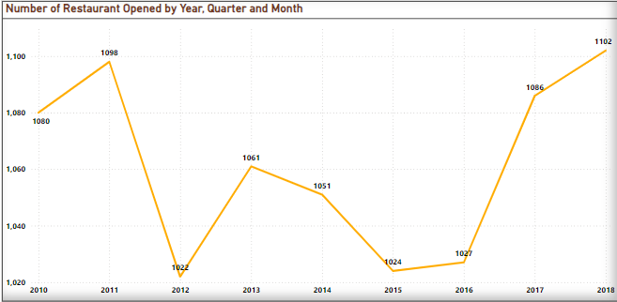
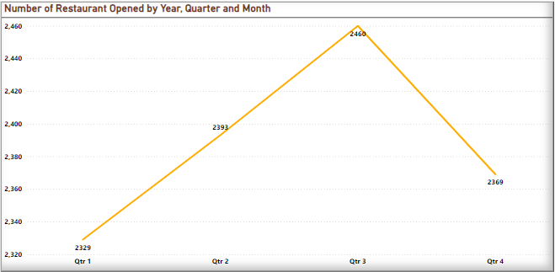
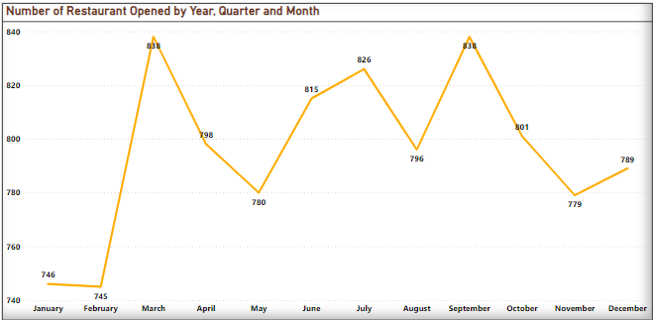
Number of Restaurants opening based on Year, Month, Quarters
Both the end of Q1 and Q3 see the highest number of new restaurant openings.
The 6.92% decrease in total restaurants between 2011 and 2012 could be attributed to factors like market saturation, economic conditions, or shifts in consumer preferences.
Key Insights:
Growth Trend in Most Active Years: The highest number of restaurant openings occurred in 2011 and 2018, with 1,098 and 1,102 new restaurants, respectively.
In 2011, Zomato expanded its operations to cities like Hyderabad, Pune, and Chennai, and also launched its mobile application. Decline in Restaurant Openings in Years:
In certain years, such as 2012, 2015, and 2016, there were fewer restaurant openings, likely due to economic downturns and regulatory changes.
In 2012, Zomato expanded globally and began acquiring restaurant listing companies in emerging markets, which could have contributed to a slowdown in local openings

Slide 7
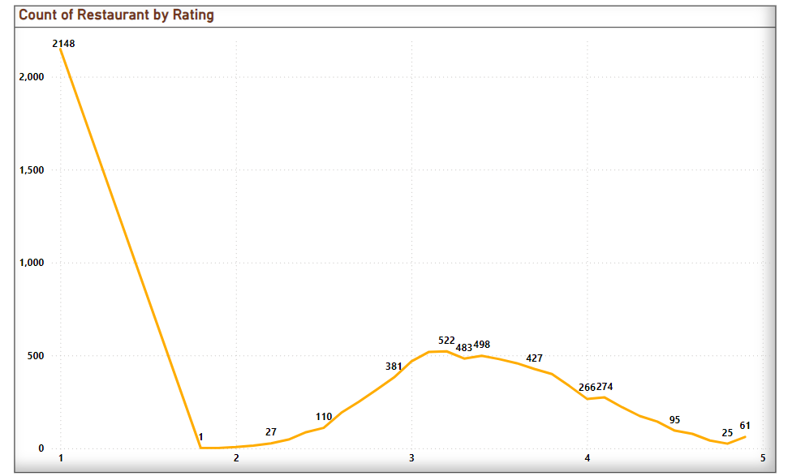
Count of Restaurant by Average Rating
Analysis:
The Majority of Restaurants fall into the Well-Rated Restaurants categories(2.0-3.0) reflecting generally positive customer experiences on Zomato.
A smaller percentage of restaurants are highly rated (4-5) suggesting that only selective restaurants consistently exceed customer expectations.
Low-rated restaurants (below 3.5) represent areas where Zomato or the restaurant owners may focus on improvement initiatives to enhance customer satisfaction and reviews.
Key Insights:
Highly Rated Restaurants (4.0 - 5.0):
Well-Rated Restaurants (2.0 -3.0):
Moderately Rated Restaurants (3.0 – 4.0):
These restaurants are typically top-tier establishments with exceptional service, food quality, and customer satisfaction.
These restaurants tend to be highly sought after, often fine-dining or niche establishments, and are mostly located in major metropolitan areas.
The majority of restaurants fall within this rating range, indicating good overall performance and customer satisfaction.
Restaurants in this range are satisfactory, offering decent dining experiences, though with potential areas to enhance food quality, service, or ambiance.

Slide 8
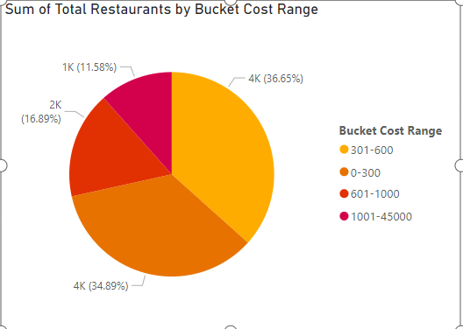
Sum of total restaurants by bucket cost range accordingly
Analysis:
Indonesia cities has Most Expensive and Luxury Restaurants.
Most preferrable Price buckets is Low-cost bucket and majorities are from India, huge number in US, UK
As there are Huge Number of Restaurants from India and average cost is low Most people prefer Low-cost Restaurants.

Slide 9
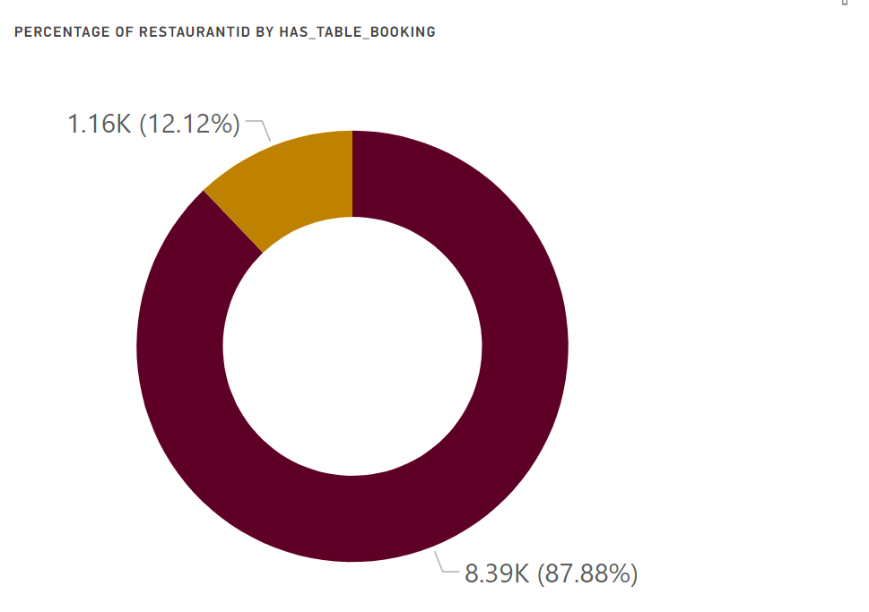
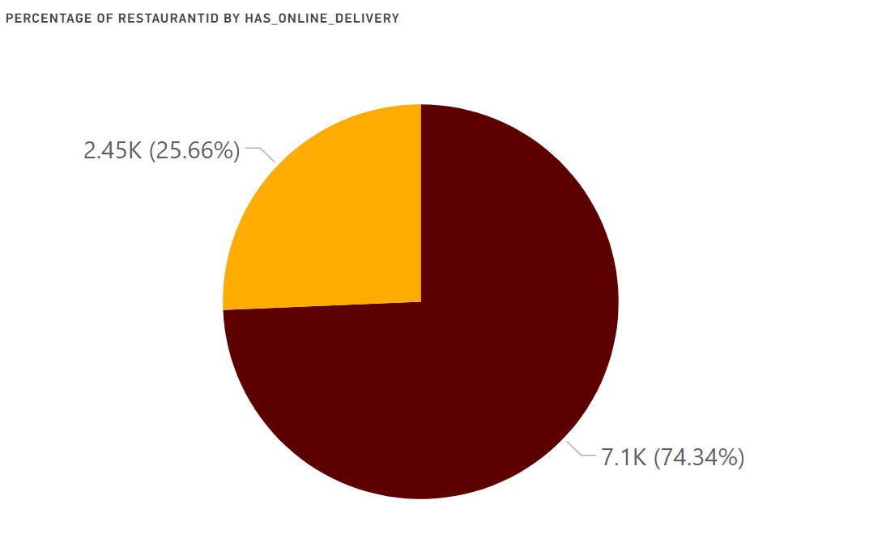
Has Table Booking: Total % Restaurants has No Table Booking: 87.88%
Total % Restaurants has Table Booking : 12.12%
Has Online Delivery :
Total % Restaurants has No Online Delivery: 74.34%
Total % Restaurants has Online Delivery: 25.66%

Slide 10
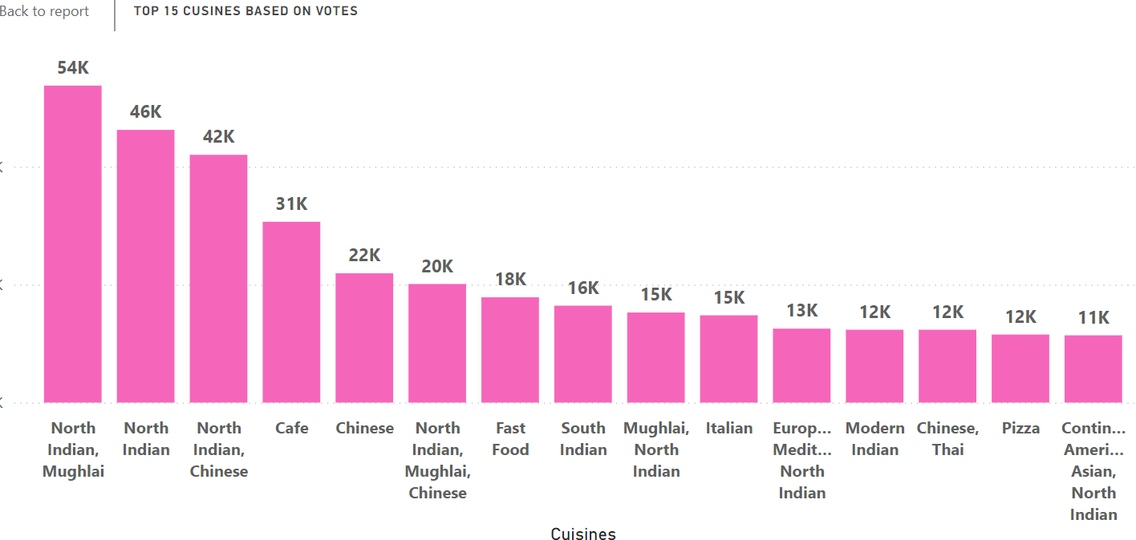
Key Insights:
Indian Dishes:
Indian Dishes are most popular in all over world.

Slide 11
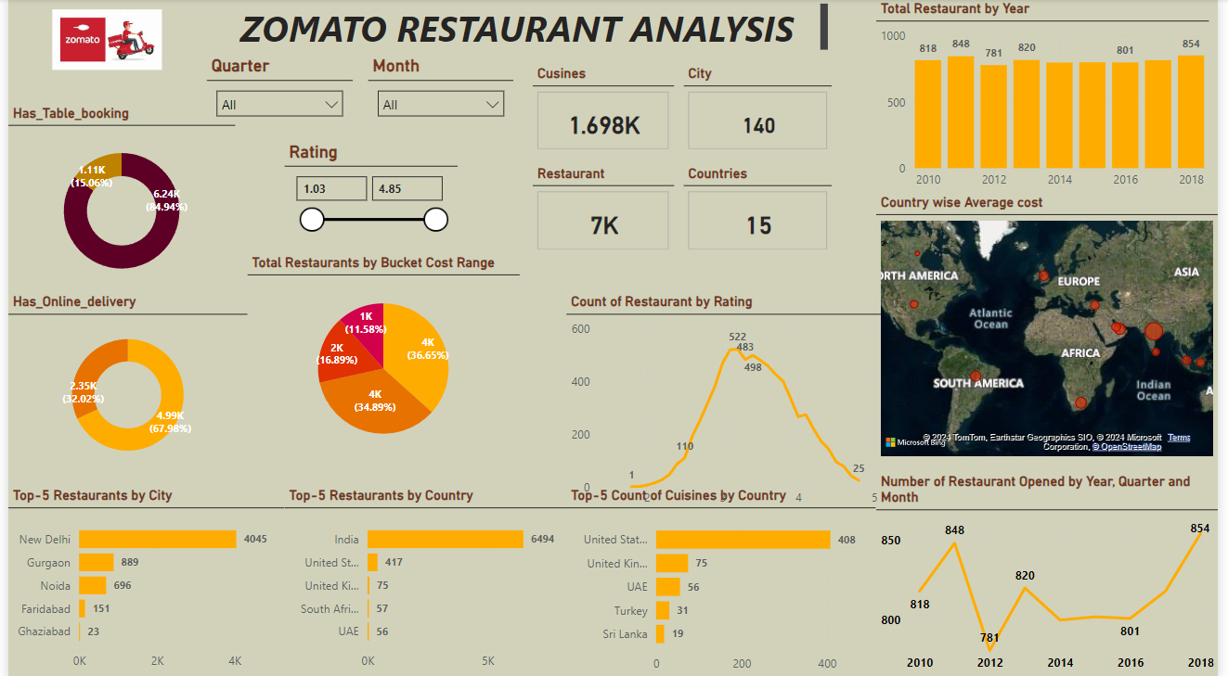

Slide 12
Table Booking Efficiency
Observation: Only 12% of restaurants offer online table booking.
Recommendation:
Improve the visibility of table booking options to increase usage and drive upselling opportunities.
Promote special events, exclusive menus, or loyalty rewards for customers using table bookings.
Online Delivery Optimization
Observation: 25% of restaurants have online delivery, which has shown a significant correlation with higher customer engagement.
Recommendation:
Focus on optimizing delivery operations and reducing delivery times in high-demand areas.
Expand reach into untapped urban and suburban regions to capture more market share.
Invest in digital marketing campaigns targeted toward areas with growing online ordering trends.
City and Regional Expansion
Observation: India dominates listings, followed by the US and UK. Emerging markets like the UAE and Australia show growth potential.
Recommendation:
Strategically expand in cities showing high demand but low saturation, such as emerging markets.
Launch city-specific promotions tailored to customer demographics and preferences.

Slide 13
Pricing and Cost Optimization
Observation: Low-cost restaurants dominate (especially in India), but premium segments in cities like Jakarta show a higher average spend.
Recommendation:
Introduce region-specific pricing strategies to attract diverse customer segments.
Leverage menu engineering to maintain profitability in both high-end and low-cost restaurants.
Customer Engagement and Ratings
Observation: Only 1389 out of 9551 restaurants achieve a rating of 4.0 or higher, with the majority in the 2.0–3.5 range.
Recommendation:
Conduct regular quality assessments to improve service consistency.
Encourage positive reviews through loyalty programs or post-dining incentives, improving overall visibility and customer trust.

Slide 14
The analysis of Zomato’s restaurant dataset reveals valuable insights into industry trends, customer behavior, and growth opportunities. These findings highlight several strategic considerations:
Adapting to Evolving Customer Preferences The shift toward online delivery reflects a growing emphasis on convenience in dining experiences, especially in urban markets. While table booking remains relevant for premium or special occasions, prioritizing delivery services is essential to meet the needs of modern consumers.
Enhancing Customer Engagement and Performance Higher-rated restaurants consistently attract more loyal customers, underscoring the importance of service quality, consistency, and customer satisfaction. Restaurants must actively monitor feedback and ratings to identify areas for improvement and foster positive experiences that drive long-term loyalty.
Leveraging Growth Patterns and Economic Trends Historical trends in restaurant openings provide valuable insights into favorable economic periods and shifts in dining habits. By understanding these patterns, Zomato can better anticipate market dynamics and support restaurants in optimizing their opening strategies.
Unlocking Growth Potential There are significant opportunities for global expansion, particularly in untapped regions with growing consumer demand. By identifying areas with low market saturation and high growth potential, Zomato and its partners can strategically establish a stronger presence and increase market share.

Slide 15
Balancing Pricing with Market Segments A diverse pricing strategy is critical to catering to various customer segments. While affordable options dominate in markets like India, premium dining thrives in cities with a preference for luxury experiences. Striking the right balance between affordability and quality will be key to maintaining competitiveness.
Flexibility as a Competitive Advantage Restaurants offering both dine-in and delivery options are best positioned to capture diverse customer preferences. The ability to adapt to changing consumer needs and offer multiple service channels will be crucial for sustained success in an increasingly dynamic market.
In summary, Zomato’s ability to leverage these insights can help optimize restaurant performance, elevate customer satisfaction, and strategically navigate growth opportunities in a competitive landscape. By focusing on service quality, operational efficiency, and market adaptability, Zomato and its partners can continue to lead the restaurant industry into the future.

Slide 16


